Slide 1
END-TO-END DATA ANALYTICS PROJECT
Customer Shopping Behavior Analysis
Uncovering actionable revenue, loyalty, and promo insights across 3,900 customer transactions using Python, MySQL, and Power BI.
Python Processing
•
MySQL Engine
•
Power BI Dashboard

Slide 2
Data Preparation Process
01
02
03
04
05
Data Loading
Initial Exploration
Missing Data Handling
Feature Engineering
Database Integration
Imported raw transaction dataset using pandas.
Structure check and summary statistics evaluation.
Created age groups and purchase frequency buckets.
Connected clean tables to MySQL for SQL querying.
Imputed Review Rating with category median values.

Slide 3

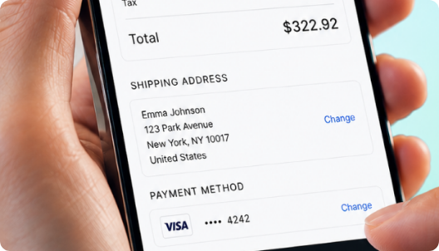
High-Value Discount Users
Customers utilizing discounts while spending above average.
Smart Shoppers
High spenders who maximize value with discount promotions.
Strategic Opportunity
Target premium customers with exclusive tailored loyalty offers.

Slide 4

Top-Rated Products
5
5
4
Blouse
Dress
Shirt
Highest customer satisfaction rating across categories.
Consistently excellent customer review feedback.
Strong customer approval and high repeat sales volume.

Slide 5

Revenue by Gender Analysis
Male Category Lead: 68%
Generating $157.9K total transaction volume.
Female Segment Share: 32%
Generating $75.1K across core retail categories.

Slide 6



Subscription Impact
68%
45%
78%
Higher Spend
Revenue Share
Loyalty Rate
Subscribers vs non-subscribers
From subscription customers
Repeat purchase frequency

Slide 7
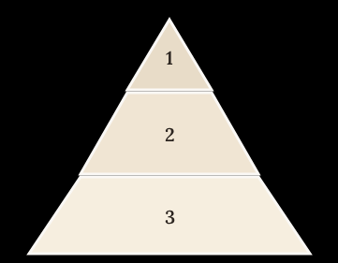
Customer Segmentation
Loyal
15% — High value customers
Returning
35% — Regular shoppers
New
50% — First-time buyers
Focus on converting New to Returning, Returning to Loyal

Slide 8

Shipping Preferences Impact
Express Shipping
Standard Shipping
$65
$58
Minimal spend variation between shipping choices indicates price inelasticity on speed.
Average cart value for expedited orders.
Average cart value for standard delivery.

Slide 9
Payment Method Preferences
Distribution of preferred checkout channels across customer transactions.
36%
28%
21%
15%
Credit Card
Digital Wallet
Venmo / Bank
Cash & Other
Highest average order value ($68) across all checkout methods.
Preferred method for younger shoppers aged 18–35.
Steady repeat transaction volume from subscription members.
In-store pickups and traditional payment processing.

Slide 10
Strategic Action Plan
Subscription Funnel
Targeted Promo
Demographic Focus
Express Shipping
Convert repeat buyers with exclusive perks to grow subscriber base.
Replace storewide discounts with personalized VIP offers.
Tailor top apparel campaigns toward highest spending age cohorts.
Bundle express shipping benefits into top loyalty tiers.

